Slide 1
Strategic Performance Management (PM)
Unit 4

Slide 2
PERFORMANCE MANAGEMENT
Performance management is a continuous process of identifying, measuring, and developing the performance of individuals and aligning performance with the strategic goals of the organization.

Slide 3
Continuous process
Alignment with strategic goals

Slide 4
TWO MAIN COMPONENTS OF DEFINITION
•
Continuous process
Process Management is ongoing. It involves a never ending process of setting goals and objectives, observing performance, and giving and receiving ongoing coaching and feedback.
•
Alignment with strategic goals
Performance Management requires that managers ensure that employee’s activities and outputs are congruent with the organizational goals.

Slide 5
CONTRIBUTION OF PERFORMANCE MANAGEMENT SYSTEM
•
Motivation to perform is increased (feedback makes people eager to learn)
Self-esteem is increased (By recognizition and appreciation)
Managers gain insight about subordinates. The definitions of job and criteria are clarified Self- insight and development are enhanced
•
•
•
•
•
Administrative actions are more appropriate
Organizational goals are made clear
fair and
•

Slide 6
Cont..,
Employees become more competent
There is better protection from lawsuits (data collected during performance evaluation can help document compliance with regulation)
There is better and more timely differentiation between good and poor performance
Supervisor’s views of performance are communicated more clearly
Organizational change is facilitated (Any change can be facilitated by continuous feedback and improvement)

Slide 7
DISADVANTAGES/ DANGERS OF POORLY IMPLEMENTED PM SYSTEM
Increased turnover
Use of misleading information
Lowered self esteem
Wasting time and money
Damaged relationship
Decreased motivation to perform.
Varying unfair standards and ratings
Emerging biases
Unclear ratings system

Slide 8
DISADVANTAGES/ DANGERS OF POORLY IMPLEMENTED PM SYSTEM
•
Increased turnover
If the process is not seen as fair employees may become upset and leave the organization.
•
Use of misleading information
If a standard system is not in place there ere multiple opportunities for fabricating information about employee’s performance.
•
Lowered self esteem
Self esteem may be lowered if feedback is provided in an inappropriate and inaccurate

Slide 9
DISADVANTAGES/ DANGERS OF POORLY IMPLEMENTED PM SYSTEM
•
Wasting time and money
Performance management systems cost money and quite a bit of time.
•
Damaged relationship
As a consequence of a incomplete system the relationship among the individual involved may be damaged.
Decreased motivation to perform.
Motivation may be lowered for many reasons, include the feeling that superior performance is not translated into tangible or intangible rewards.
•

Slide 10
DISADVANTAGES/ DANGERS OF POORLY IMPLEMENTED PM SYSTEM
•
Varying unfair standards and ratings
Both standards and individual ratings may vary across and with in units and also be unfair.
•
Emerging biases
Personal values, biases, and relationships are likely to replace organizational standards.
•
Unclear ratings system
Because of poor communication employees may not know how their ratings are generated and how the ratings are translated into rewards.

Slide 11
REWARD SYSTEM
A reward system is the set of mechanisms for distributing both tangible and intangible returns as part of an employment relationship.

Slide 12
Various Type Of Return
Base pay
Cost-of living Adjustments and contingent pay (Merit Pay)
Short-Term Incentives
Long-Term Incentives
Income Protection
Work/Life Focus
Allowances
Relational Returns (Include recognition, status, employment security, learning opportunities etc)

Slide 13
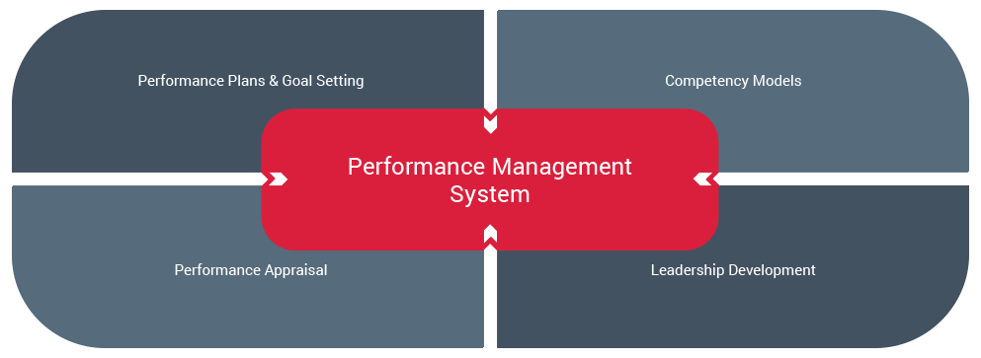
PM SYSTEM

Slide 14
PERFORMANCE MANAGEMENT SYSTEM
RETURNS
DEGREE OF DEPENDENCY
Cost-of-living adjustment
Income protection
Work/life focus
Allowances
Relational returns
Base pay
Contingent pay
Short-term incentives
Long-term incentives
Low
Low
Moderate
Moderate
Moderate
Moderate
High
High
High

Slide 15
PERFORMANCE MANAGEMENT SYSTEM - Features
Strategic
Administrative
Informational
Developmental
Organizational maintenance
Documentational

Slide 16
PERFORMANCE MANAGEMENT SYSTEM
Strategic:
To help top management achieve strategic business objectives.
Administrative:
To furnish valid and useful information for making administrative decisions about employees
Informational:
To inform employees about how they are doing and about the organization’s and the supervisor’s expectations.

Slide 17
PERFORMANCE MANAGEMENT SYSTEM
Developmental:
To allow managers to provide coaching to their employees.
Organizational maintenance:
To provide information to be used in workplace planning and allocation of human resources.
Documentational:
To collect useful information that can be used for various purposes.

Slide 18
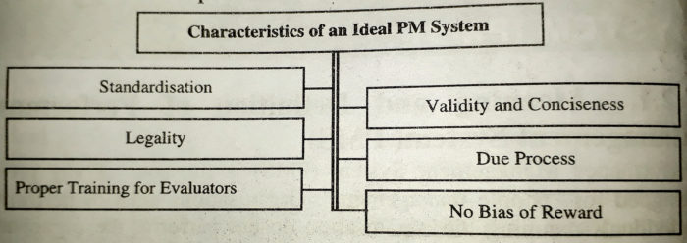
characteristics of an ideal PM system

Slide 19
CHARACTERISTIC OF AN IDEAL PM SYSTEM
Strategic Alignment
Thoroughness
Practicality
Meaningfulness
Specificity
Identification of effective and ineffective performance
Reliability
Validity
Acceptability and fairness
Inclusiveness
Openness
Correct ability
Standardization
Ethicality

Slide 20
CHARACTERISTIC OF AN IDEAL PM SYSTEM
○ Strategic Alignment:
The system should be aligned with the unit and organization's strategy.
○
Thoroughness:
The system should be thorough regarding four dimensions
Employees should be evaluated
Major Job responsibilities should be evaluated
-
Evaluate performance spanning (Entire Review Period rather just few weeks)
Feedback is provided on both positive and negative performance
-

Slide 21
CHARACTERISTIC OF AN IDEAL PM SYSTEM
○ Practicality:
Systems that are too expensive, time-consuming, convoluted will obviously not be effective. Good systems that are
-Easy to use
-available for use
-it is acceptable for those who use it for decision.
-Benefits of the system out weight the cost.
○
Meaningfulness:
The system must be meaningful in several ways.
Standards and evaluations for each job function are important and relevant.
Only the functions that are under the control of the employee are measured.

Slide 22
CHARACTERISTIC OF AN IDEAL PM SYSTEM
-
System provides for continuing skill development of evaluation.
- Results are used for important administrative decisions.
○ Specificity:
Detailed guidance is provided to employees about what is expected of them and how they can meet these expectations.
○ Identification of effective and ineffective performance:
The system distinguishes between effective and ineffective behavior and results, thereby also identify employees displaying various levels of performance effectiveness.

Slide 23
CHARACTERISTIC OF AN IDEAL PM SYSTEM
○ Reliability:
Measures of performance are consistent and are free of
error.
○ Validity:
- Measure includes all critical performance factors
- Measures do not leave out any important performance factor
-Measures do not include factors outside employee control.
○ Acceptability and fairness:
Employees perceive the performance evaluation and rewards received relative to the work performed as fair. (Distributive justice)
Employees perceive the procedure used to determine the rating and subsequent rewards as fair. (Procedural justice)

Slide 24
CHARACTERISTIC OF AN IDEAL PM SYSTEM
○ Inclusiveness:
Employees participate in the process of creating the system by providing input on how performance should be measured.
○ Openness:
Good systems have no secrets.
-performance is evaluated frequently and feedback is provided on an ongoing basis.
- Appraisal meets in a two-way communication process and not one-way communication delivered from the supervisor to the employee.
-Standards are clear and communicated on an ongoing basis.
-Communications are factual, open, and honest.

Slide 25
CHARACTERISTIC OF AN IDEAL PM SYSTEM
○ Correct ability:
There is an appeals process, through which employees can challenge unjust or incorrect decisions.
○ Standardization:
Performance is evaluated consistently across people and time.
○ Ethicality:
Supervisors suppress their personal self-interest in providing evaluations.
Employee privacy is respected.
Supervisors evaluate performance dimensions for which they have sufficient information only.

Slide 26
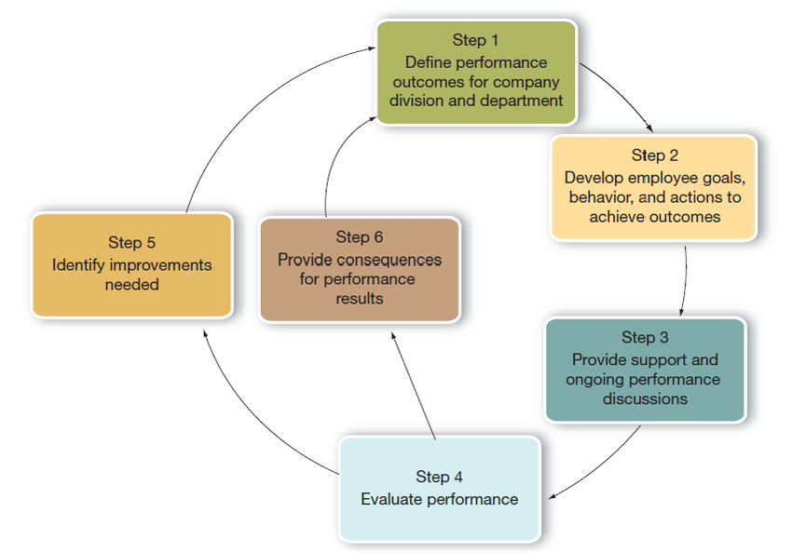
six‐step performance management process

Slide 27
RESOURCES AND DEVELOPMENT ACTIVITIES
○ Performance management system serves as important “feeders” to other human resources and development activities.
○ Performance management training.
Performance Management provides information on developmental needs for the employees. In the absence of good performance management system, it is not clear that organizations will use their training resources in the most efficient way.

Slide 28
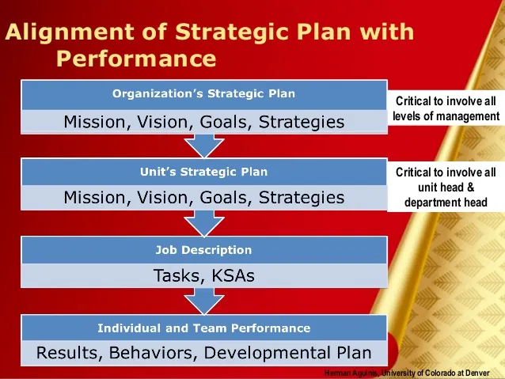

Slide 29
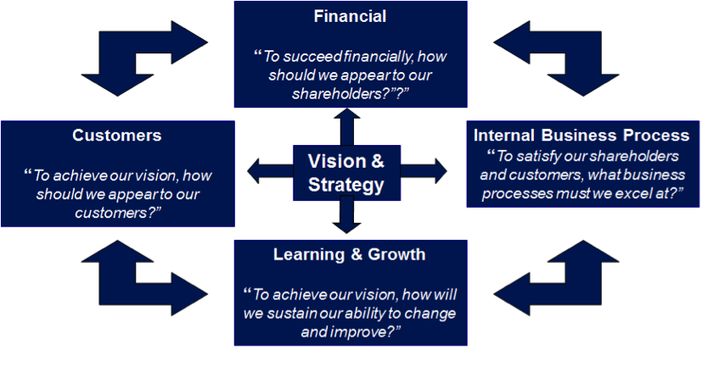

Slide 30
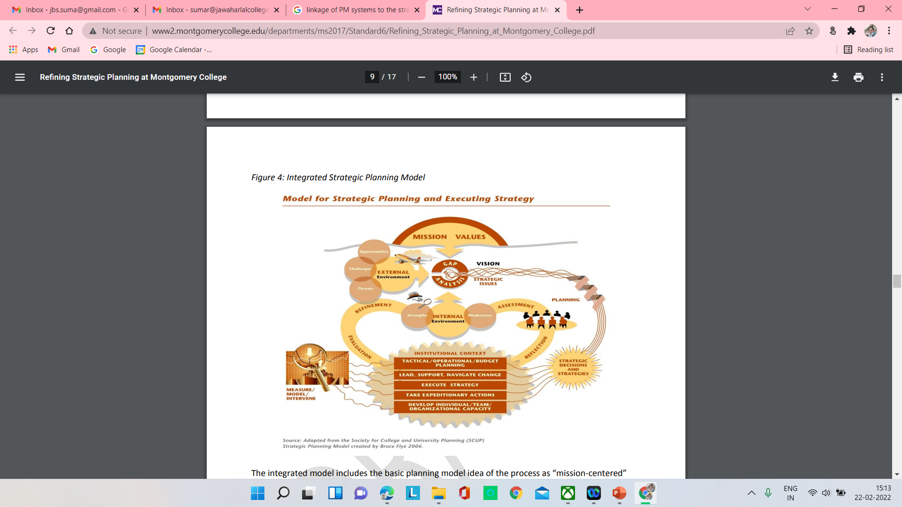

Slide 31
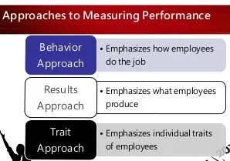

Slide 32
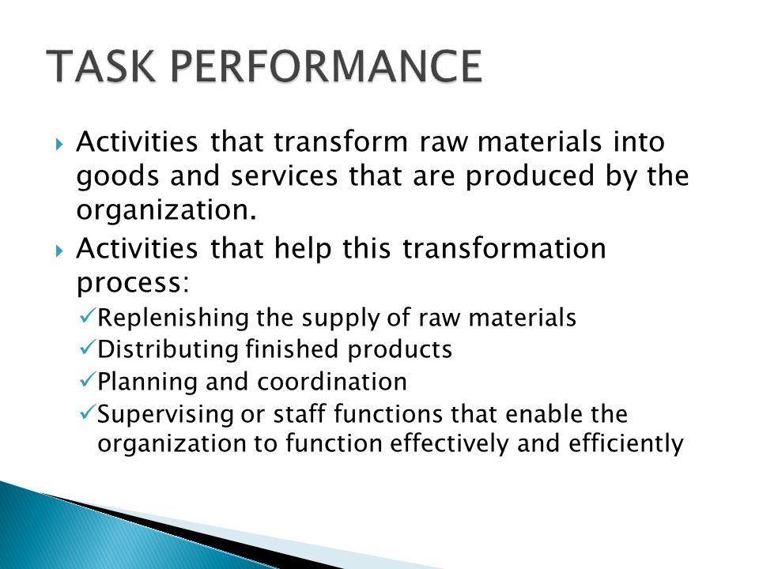

Slide 33
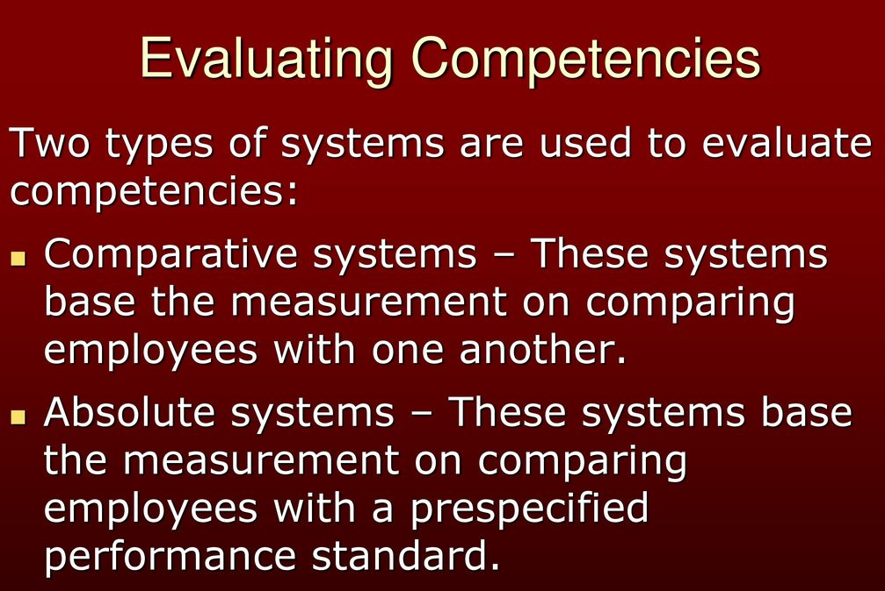

Slide 34
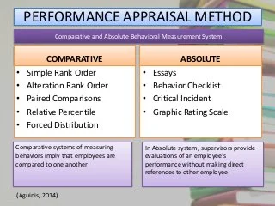

Slide 35
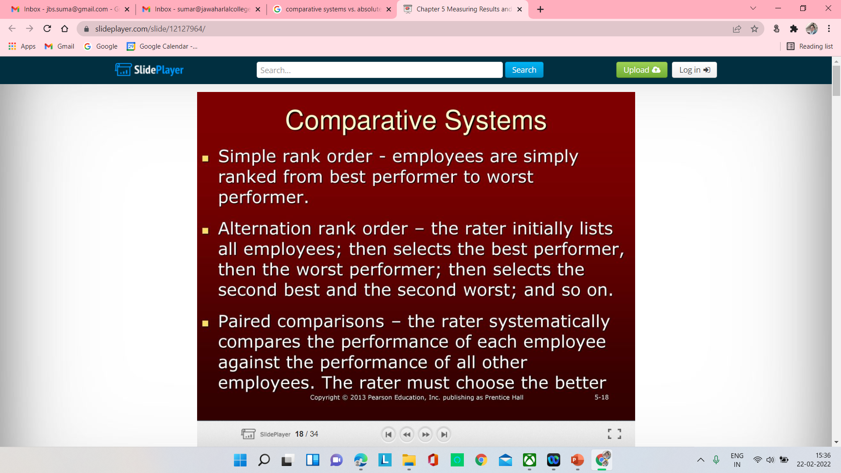
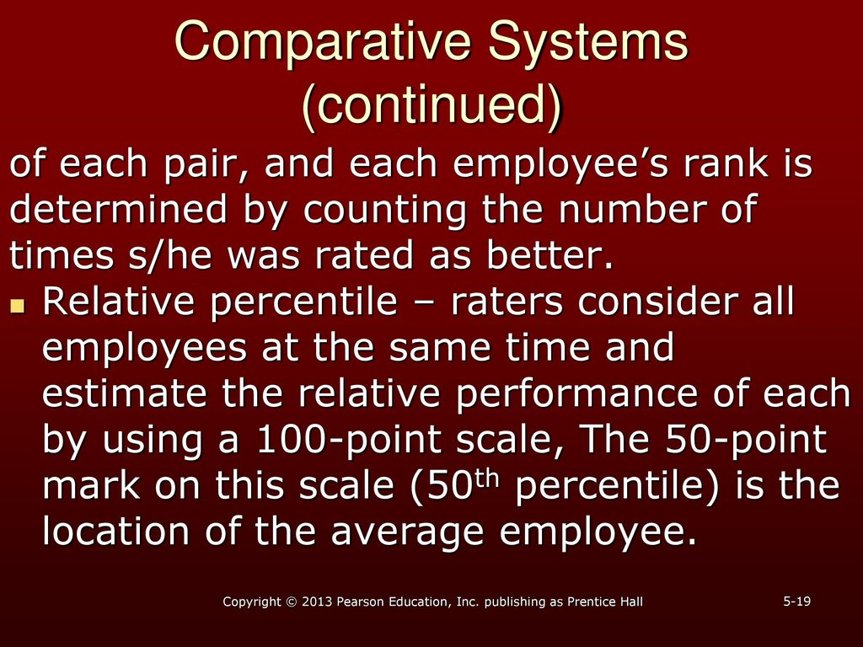

Slide 36
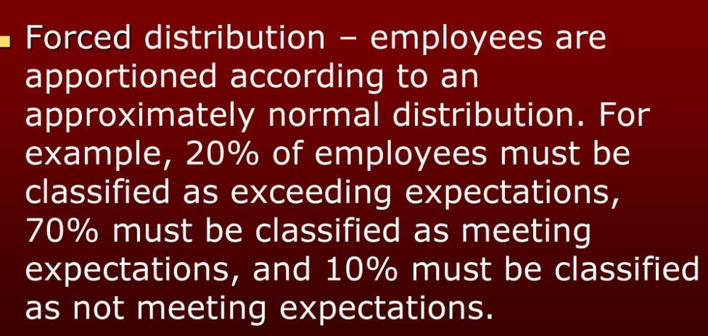

Slide 37
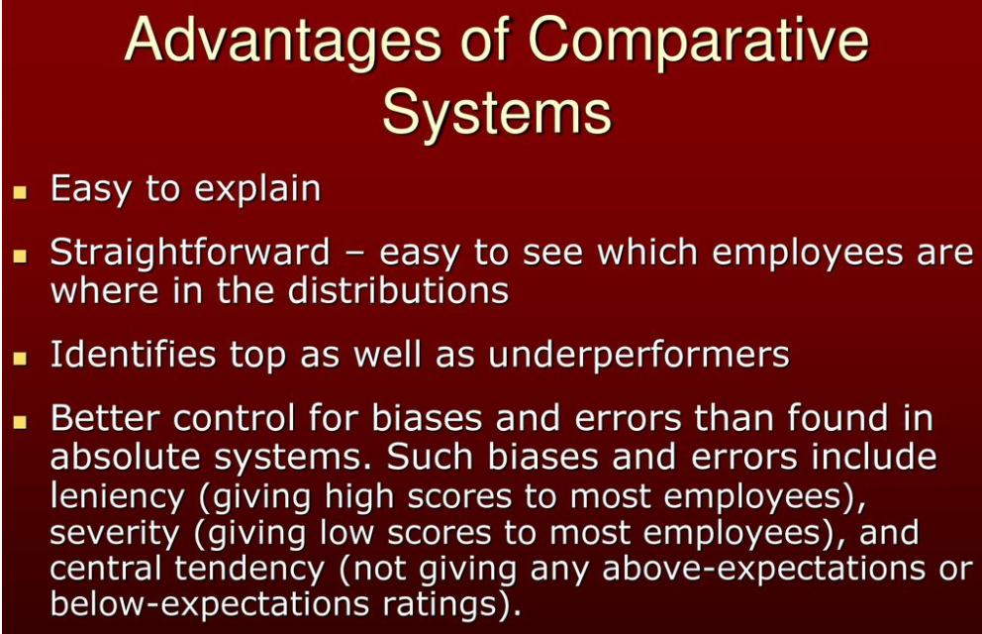
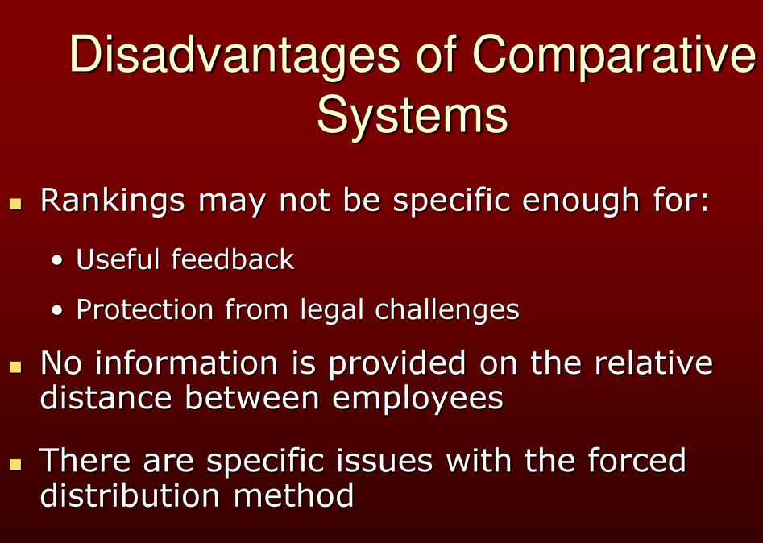

Slide 38
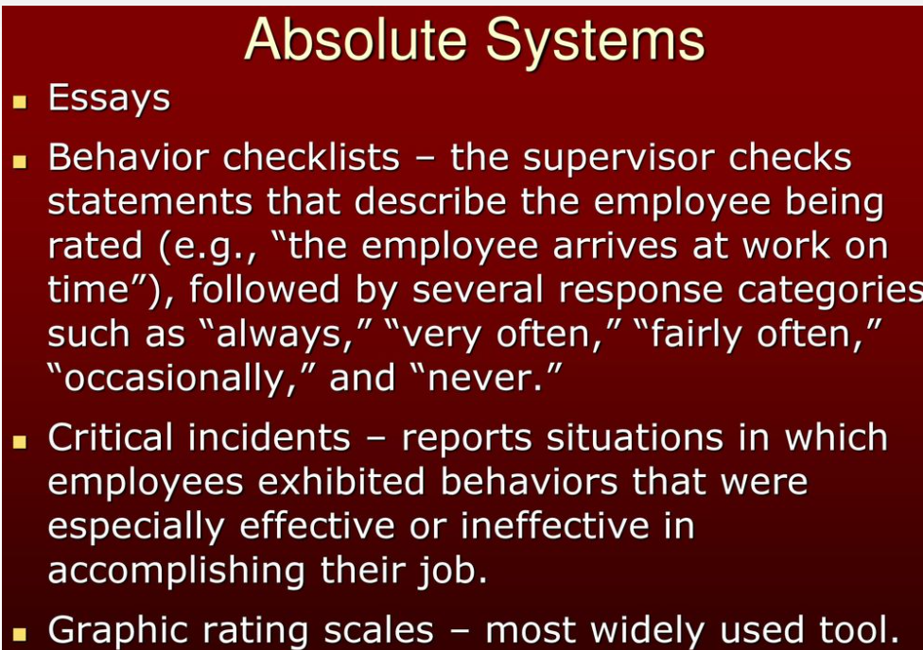

Slide 39
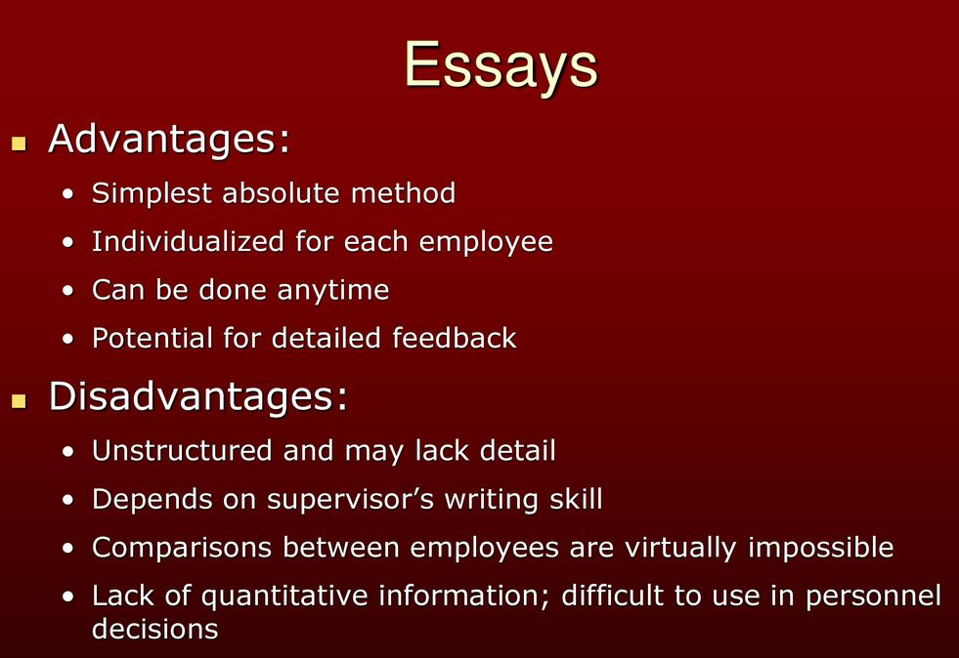
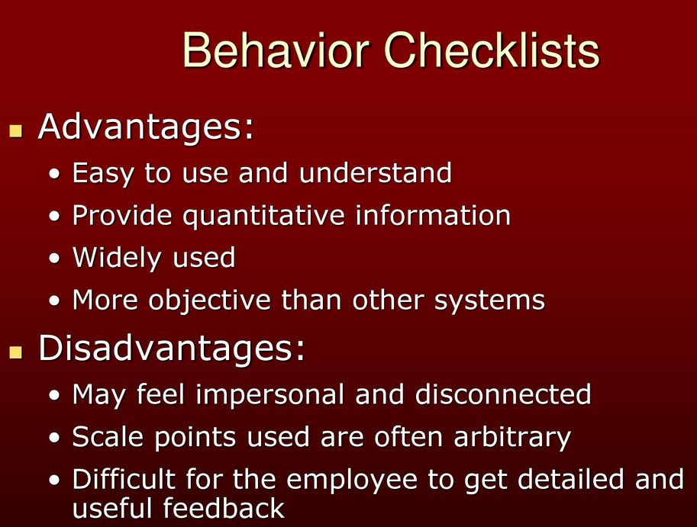

Slide 40
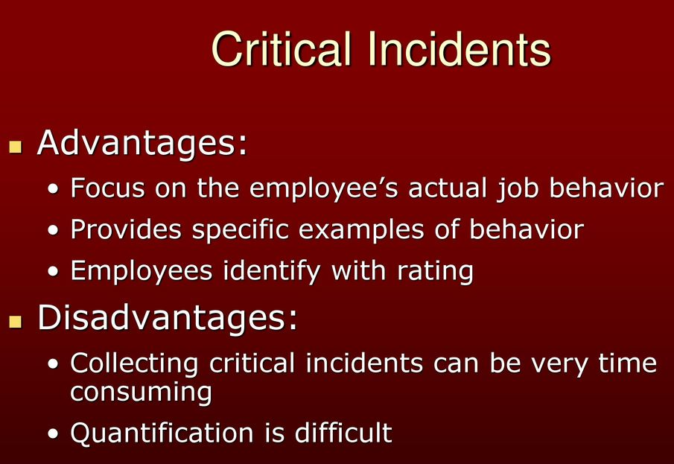
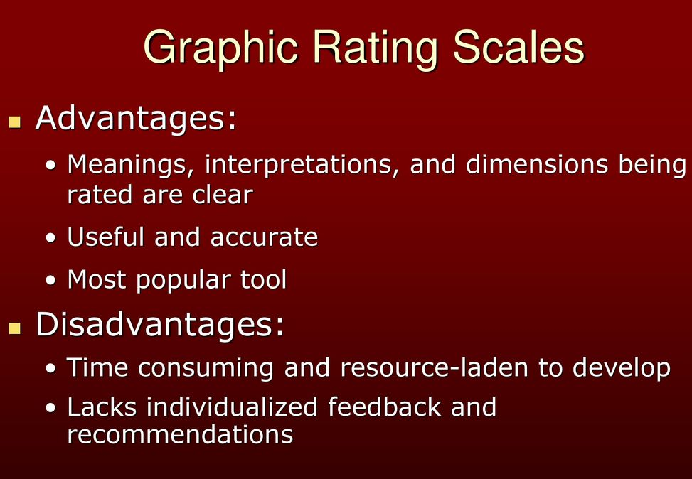

Slide 41
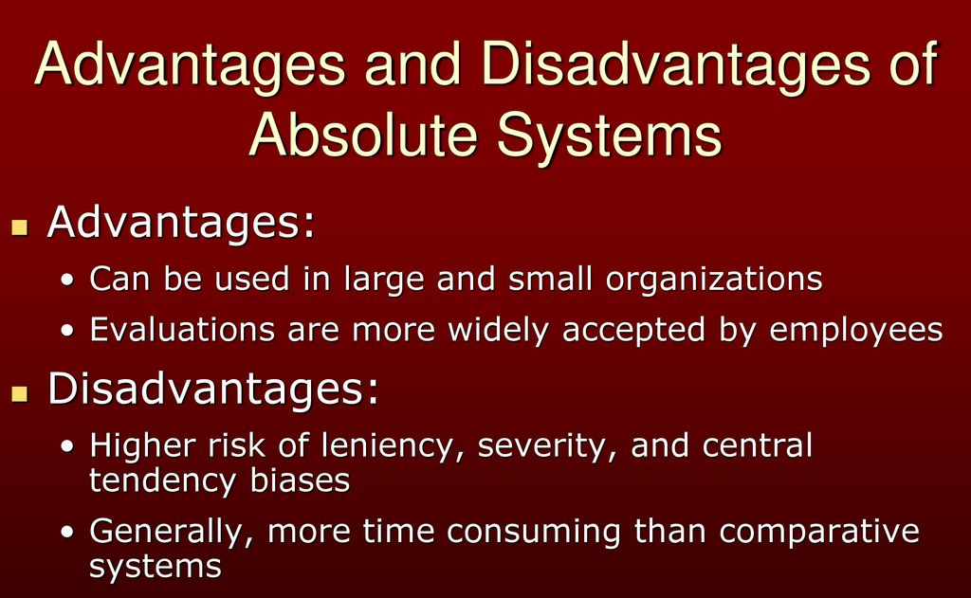

Slide 42
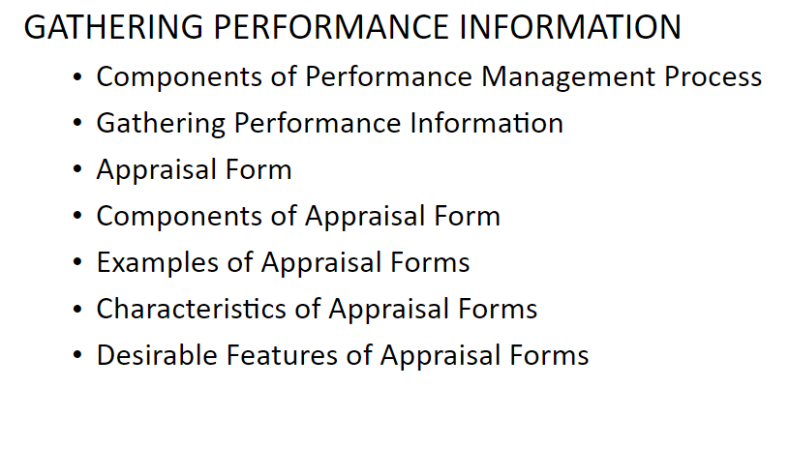
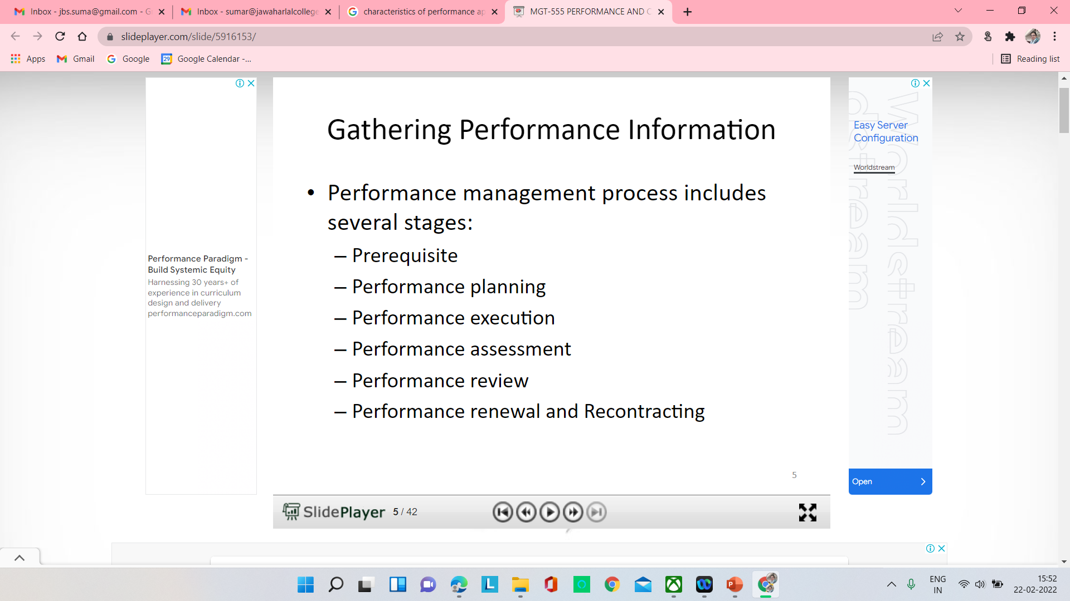

Slide 43
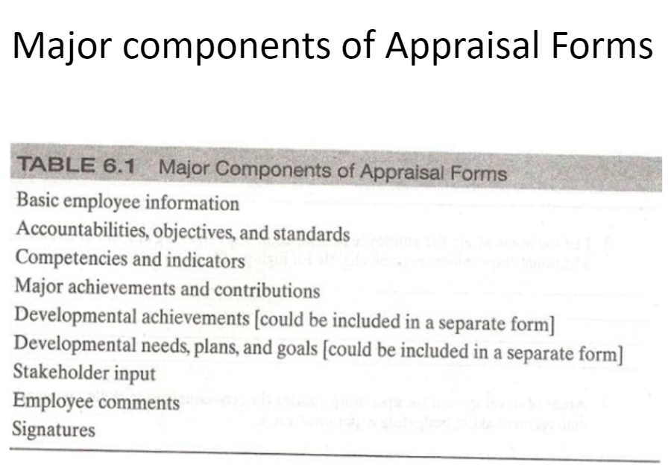

Slide 44
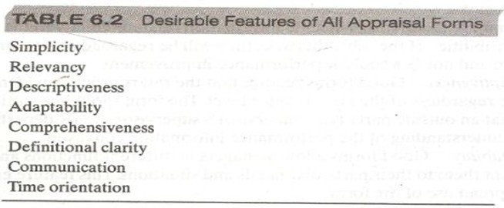

Slide 45
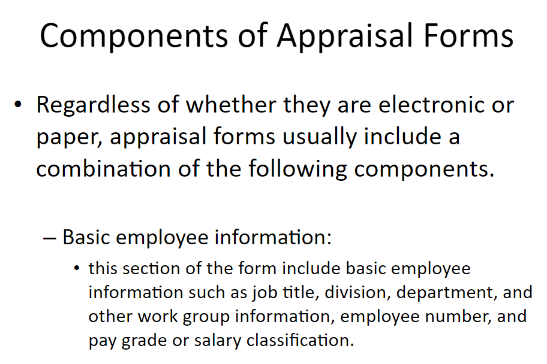
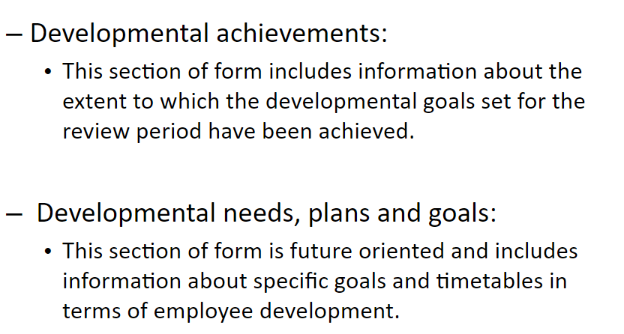
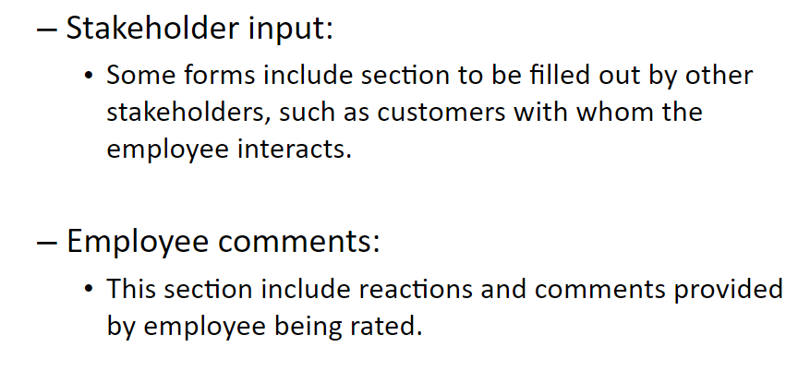
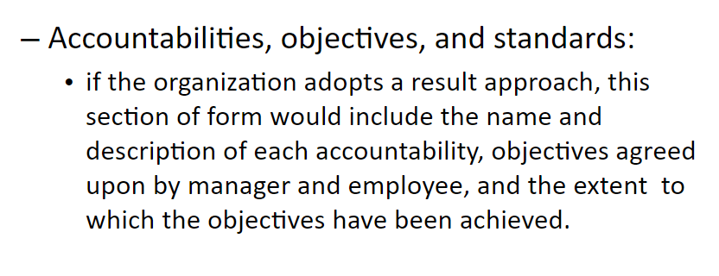
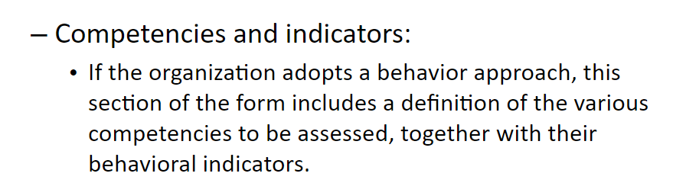
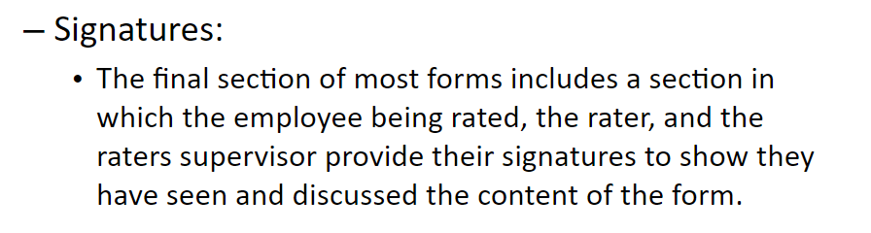
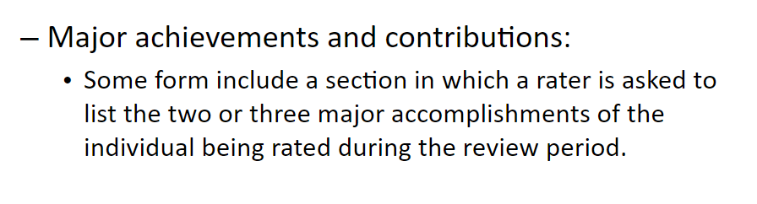

Slide 46
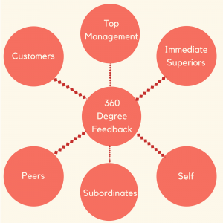
360 degree feedback

Slide 47
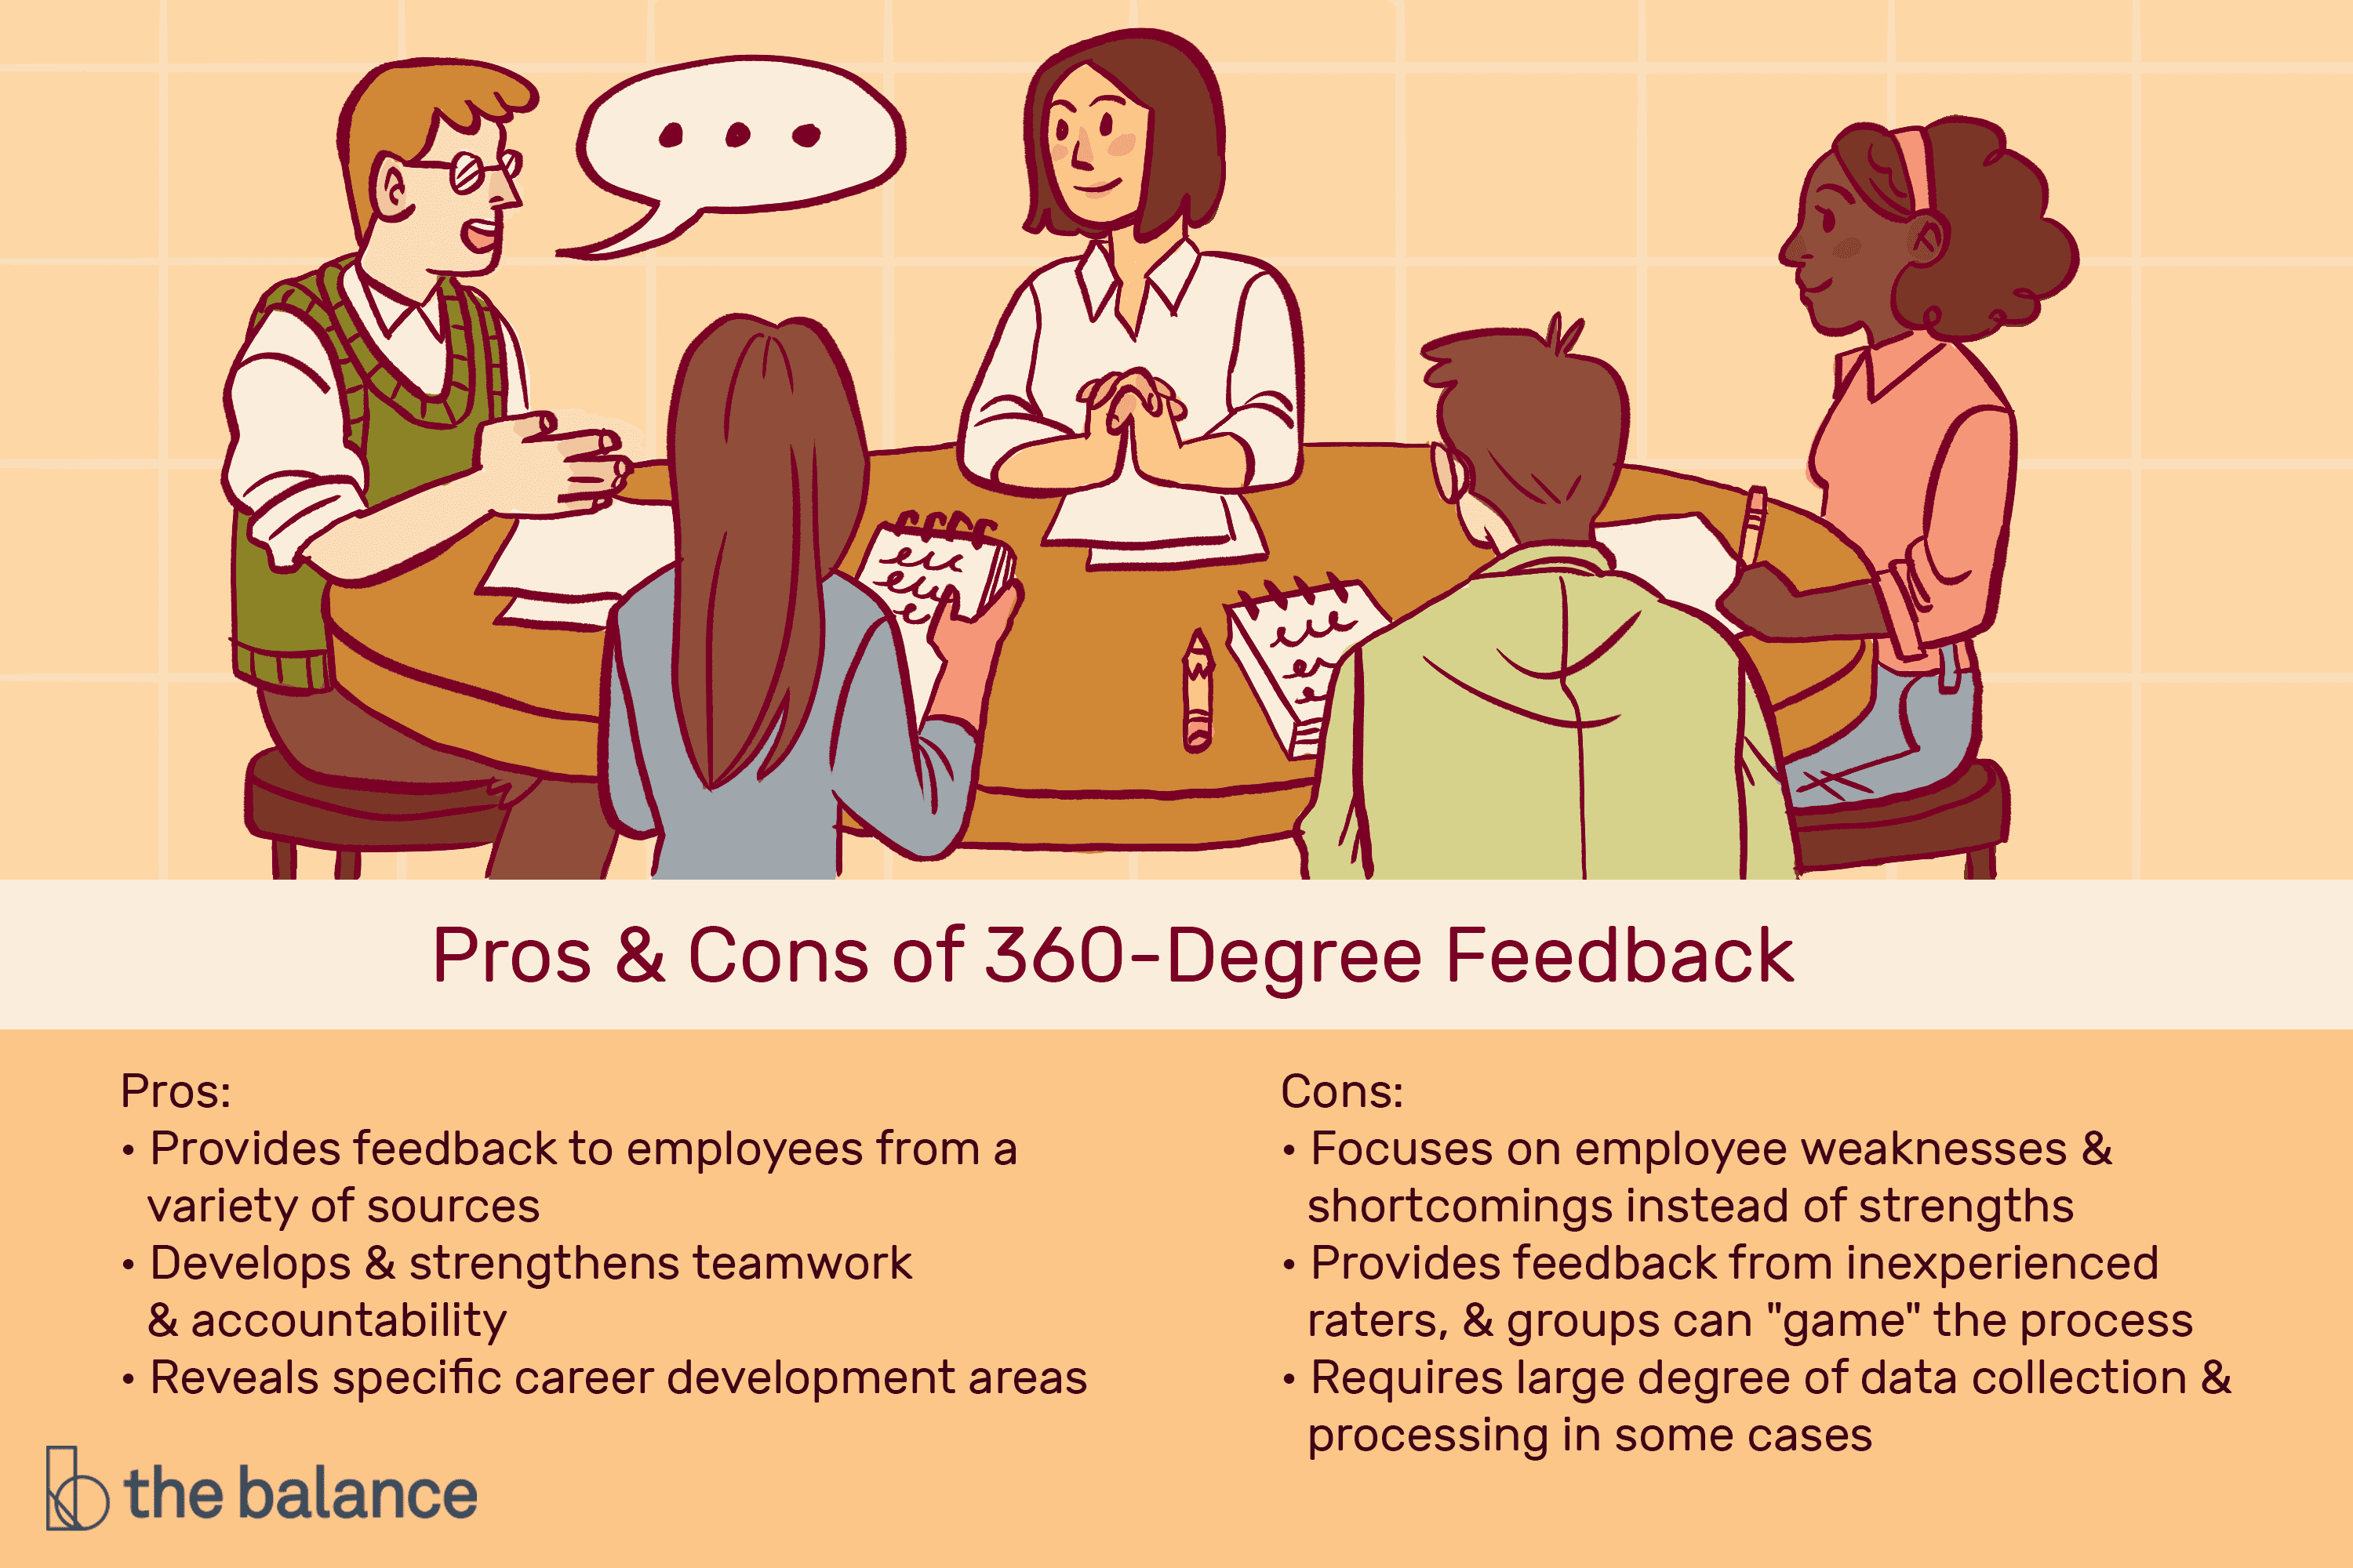

Slide 48
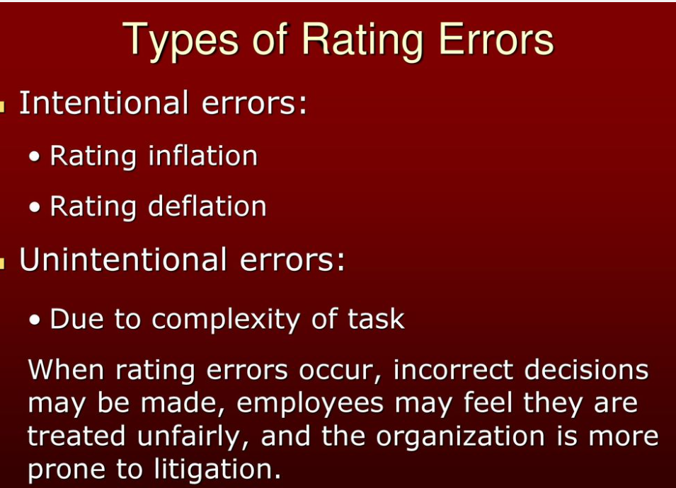
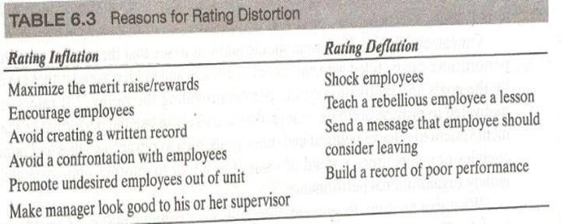

Slide 49
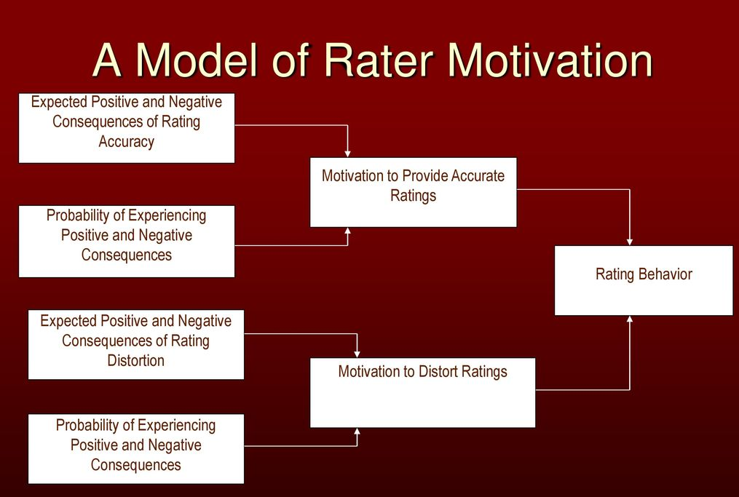

Slide 50
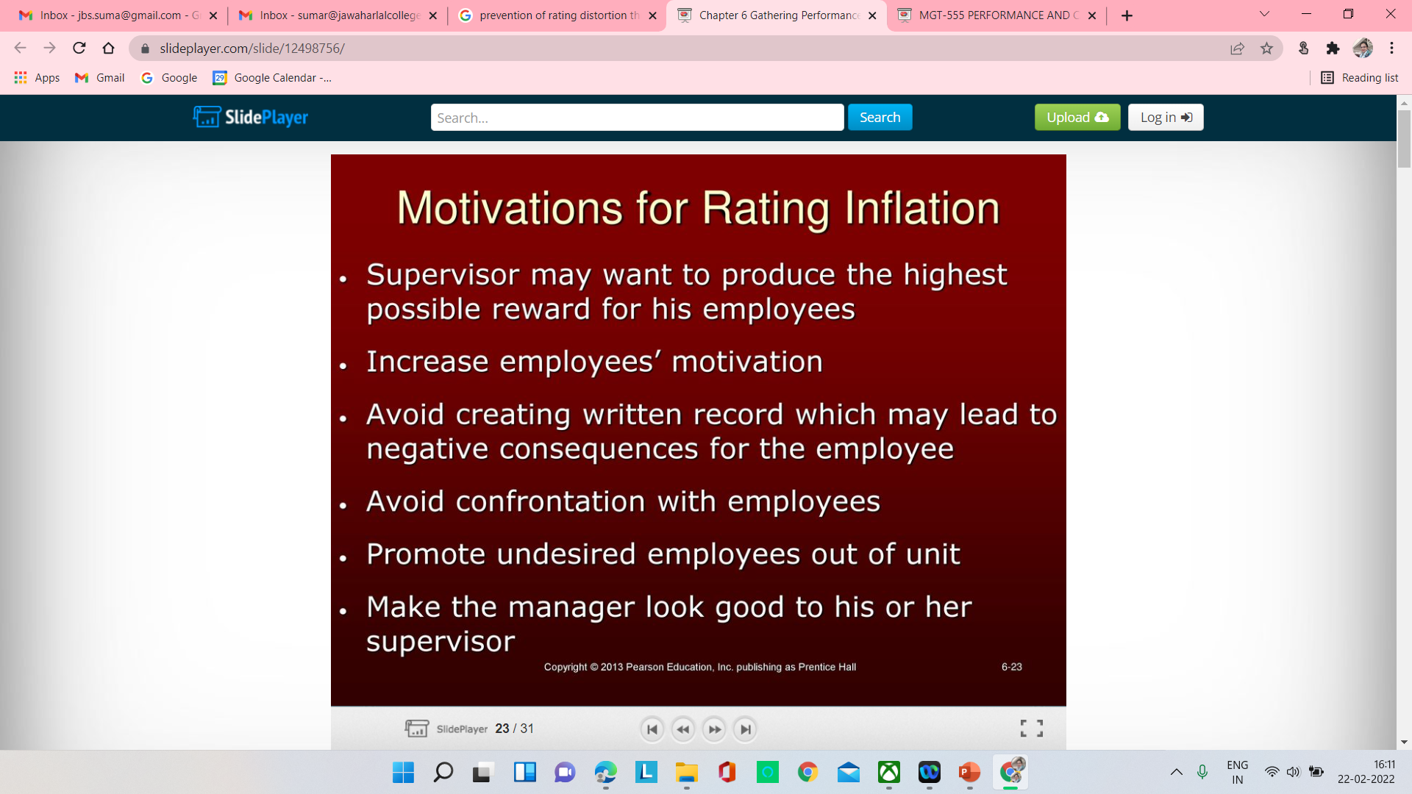
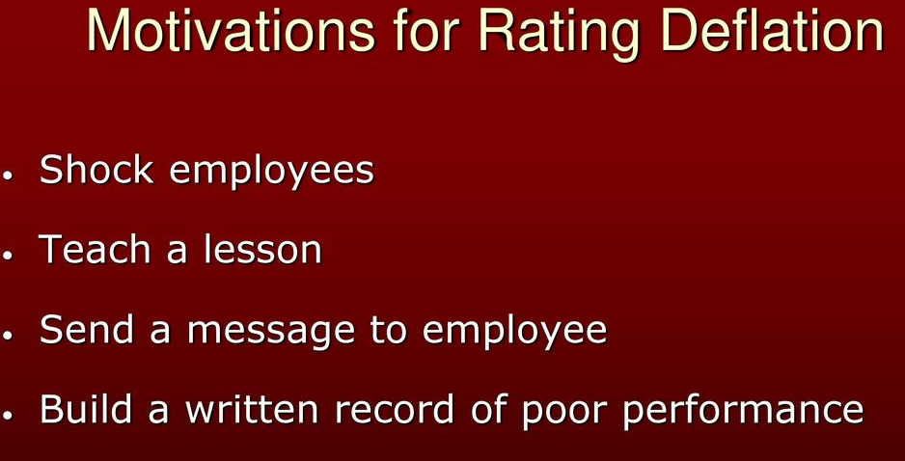

Slide 51
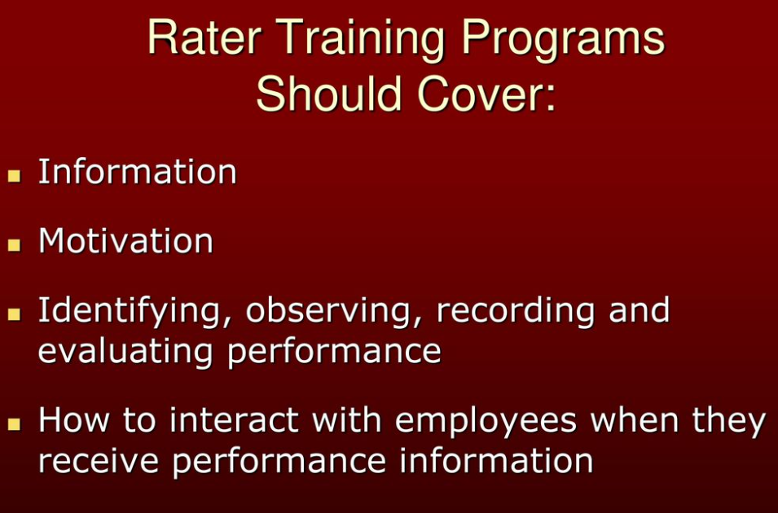
prevention of rating distortion through rater training and appeals process

Slide 52
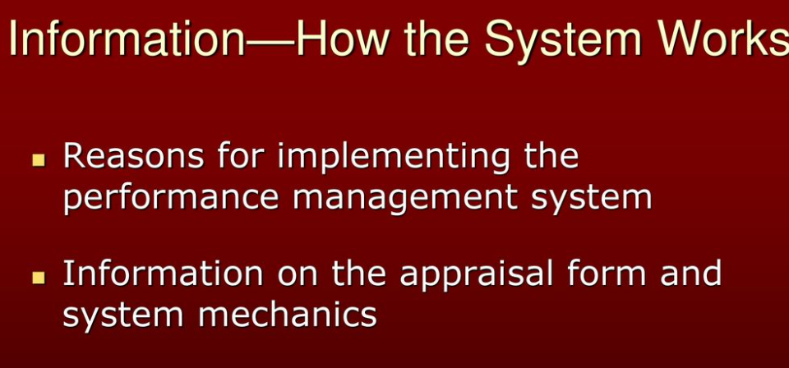
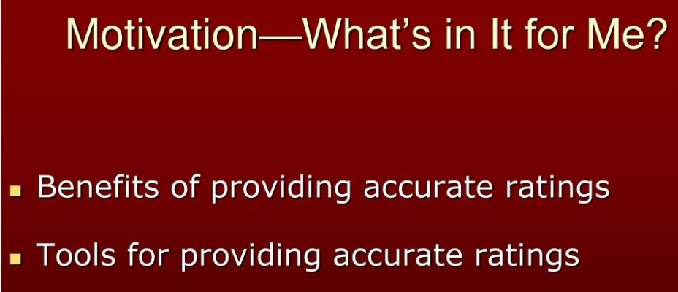
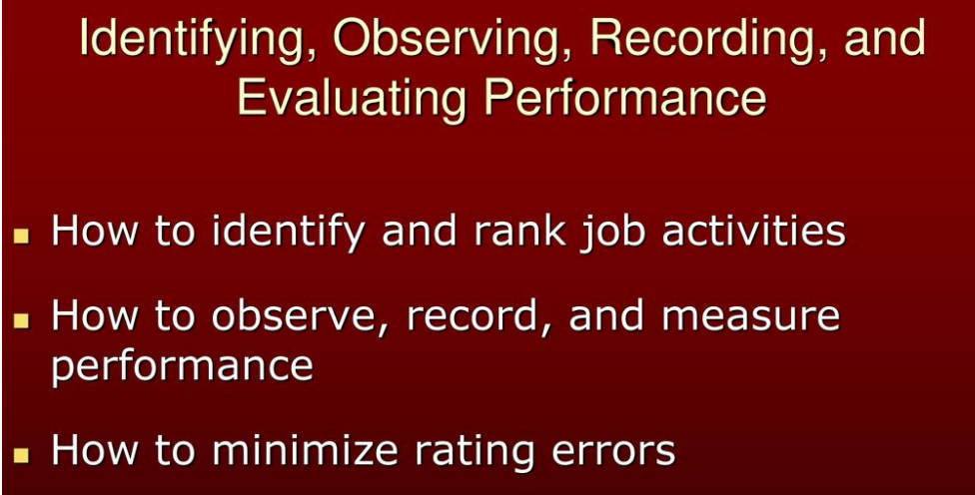

Slide 53
